Slide 1
Sections 7.2 & 7.3 of Gift of Fire
Baptiste Saliba
**Still have to add pictures and references**

Slide 2
Outline
7.2 – The Digital Divide
What is the Digital Divide?
History
Modern Tech Divides
Modern Solutions
7.3 – Neo-Luddites
What is a Neo-Luddite?
Arguments against technology
Ethical analysis of arguments

Slide 3
A New Type of Divide
7.2
Digital Divide: A divide created by a difference in access to computers between the different demographics and economic classes
Creates “Haves” and “Have-nots”
Factors:
Ease of use of devices
Price

Slide 4
History of Digital Divide
7.2
All had same access to modern technology (no access)
Gained access first:
Wealthy
Urban regions
Parental households
Didn’t gain access
Women
Rural regions
Hispanics

Slide 5
Spread of Technology (7.2)
7.2
Internet Cafés
Government efforts
Schools
Libraries
Effects
Racial gap disappeared
Wealth gap decreased
** More accurate to say creates “Haves” and ”Have-laters”
(Wang Yu Internet Café, 2014)

Slide 6
Modern Tech Divides
7.2
Broadband: A method used for large capacity communications
Ex) Coaxial, optical fiber, radio, etc.
Have-nots
Low income households
Content creators vs. consumers
Socioeconomic divide

Slide 7
Modern Tech Divides
7.2
Internet Divide
2 billion people use Internet
5 billion do not
Causes:
Poverty
Isolation
Poor economies
Politics
(Internet Use, 2012)
(Harris, 2017)

Slide 8
Modern Solutions
7.2
Company attempts
Internet courses
Funded by companies
Larger customer bases
Government programs
One Laptop per Child: Provide cheap durable laptops to developing countries
Technical infrastructure required
Exodus of young people

Slide 9
Domestic Source
Type of Internet use in younger generations
Upper class
Learning instruments
Reading
Education
Lower class
TV
Games
Non-academic purposes
Source citation

Slide 10
Neo-Luddites
7.3
Luddite: Refers to someone who is anti-technology
Workers who burned looms
Believed technology causes many problems
Dangers of technology
Loss of freedom
Loss of privacy
(The Industrial Revolution,2010)

Slide 11
Key Neo-Luddites
7.3
Kirkpatrick Sale
Destroys nature
Promotes money making and production
Neil Postman
Promotes isolation
Results in loss of independence
Selove & Scheuer
Erodes family and community life

Slide 12
Arguments Against Technology
7.3
1) Unemployment and deskilling
Answer – Causes disruption not unemployment
2) New Needs
Answer – Wants not needs
3) Disintegration of society
4) Separation of humans from nature

Slide 13
Arguments Against Technology
7.3
5) Social inequity
Answer– Ignores history
6) Benefits for big businesses
Answer – Arab Spring
7) Underdevelopment of social skills
8) Unsolved human issues
Answer – Have had problems for thousands of years
(Head in Phone, 2018)

Slide 14
Arguments Against Technology
7.3
9) Production of unneeded things
Answer– Modern comfort
10) Unwanted changes
Answer– Wanting vs. Paying
Walmart example

Slide 15
Technological Impacts
7.3
Environmental
Decreased waste
Increased energy consumption
Societal
Increased life expectancy
Developed modern medicine
Decreased amount of income spent on food

Slide 16
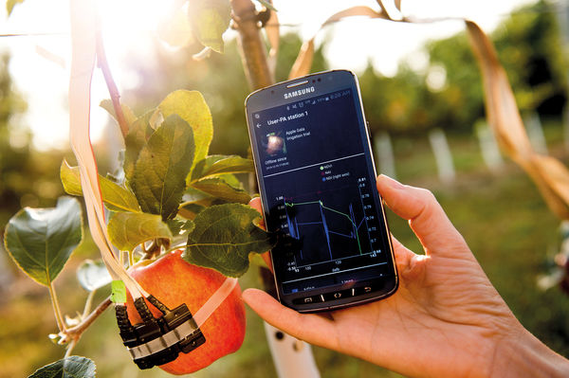
International Source
Robotic agriculture
Sustainable agriculture
Improved soil quality
20-40% increase in production
Safer distribution of pesticide
(E-agriculture, 2017)
(King, 2017)

Slide 17
Luddite Views
7.3
Negative views on:
Capitalism
Profits vs. wellbeing of workers
Corporations control everything
Transportation
Communications
Negative impact on society

Slide 18
Ethical Analysis
7.3
“The capacity to decide that a thing is right when it enhances the integrity, stability, and beauty of nature and is wrong when it does otherwise.”
Both Utilitarian (Mill)!
Baase = needs of people > nature
Sale = nature > needs of people

Slide 19
Is Technology Bad?
Should we live in less comfort in order to preserve the environment?

Slide 20
References
Baase, S. (2013). A gift of fire: Social, legal, and ethical issues for computing technology (4th ed.). Boston: Pearson.
Betsy, R. (2010). The Industrial Revolution. Retrieved from http://covertress.blogspot.com/2010/10/notes-toward-neo-luddite-manifesto.html
Bobnet, Carna (2012) Relative average utilization of IPv4 addresses. Retrieved from https://gigaom.com/wp- content/uploads/sites/1/2013/09/geovideo.gif?w=708
King, A. (2017) Technology: The Future of Agriculture. Nature 21: 544. DOI 10.1038/544S21a
Harris, Courtenay (2017) A socioeconomic related ‘digital divide’ exists in how, not if, young people use computers. PLoS ONE 12: 3. 10.1371/journal.pone.0175011
Windszus, Jan (2017) E-agriculture. Retrieved from http://www.e-agriculture.org/sites/default/files/u81245/ripe_for_the_picking.png
Technode (2014) Wang Yu Internet Café. Retrieved from https://technode.com/wp-content/uploads/2014/09/1412073371426screencapture.png
L., Eddie (2018) Head in Phone. Retrieved from http://womansvibe.com/spine-deformation-alert/

Slide 21
Question 1
What is not a common argument, by Luddites, against technology?
Makes for underdeveloped social skills
Benefits big businesses the most
Solves human problems while creating needs
Results in deskilling and unemployment

Slide 22
Question 1
What is not a common argument, by Luddites, against technology?
Makes for underdeveloped social skills
Benefits big businesses the most
Solves human problems while creating needs
Results in deskilling and unemployment

Slide 23
Question 2
Who lacked access to digital technology in 1990s?
Women
Hispanics
Households with children
Rural regions

Slide 24
Question 2
Who lacked access to digital technology in 1990s?
Women
Hispanics
Households with children
Rural regions

Slide 25
Question 3
What is not a technological impact?
Results in unemployment
Life expectancy increases
Reduces environmental waste
Loss of privacy

Slide 26
Question 3
What is not a technological impact?
Results in unemployment
Life expectancy increases
Reduces environmental waste
Loss of privacy

